Slide 1
11-6 HDLC
High-level Data Link Control (HDLC) is a bit-oriented protocol for communication over point-to-point and multipoint links.
Topics discussed in this section:
Configurations and Transfer Modes
Frames
Control Field
11.<number>

Slide 2
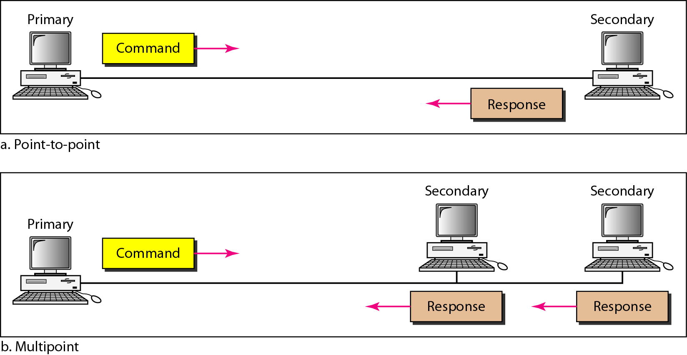
Figure 11.25 Normal response mode
11.<number>

Slide 3
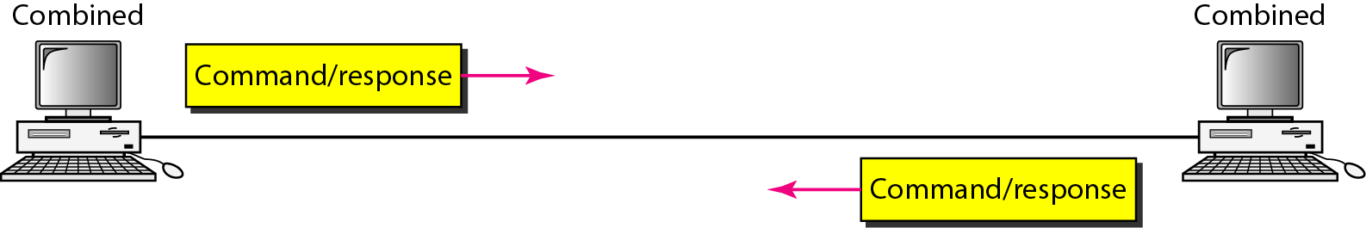
Figure 11.26 Asynchronous balanced mode
11.<number>

Slide 4
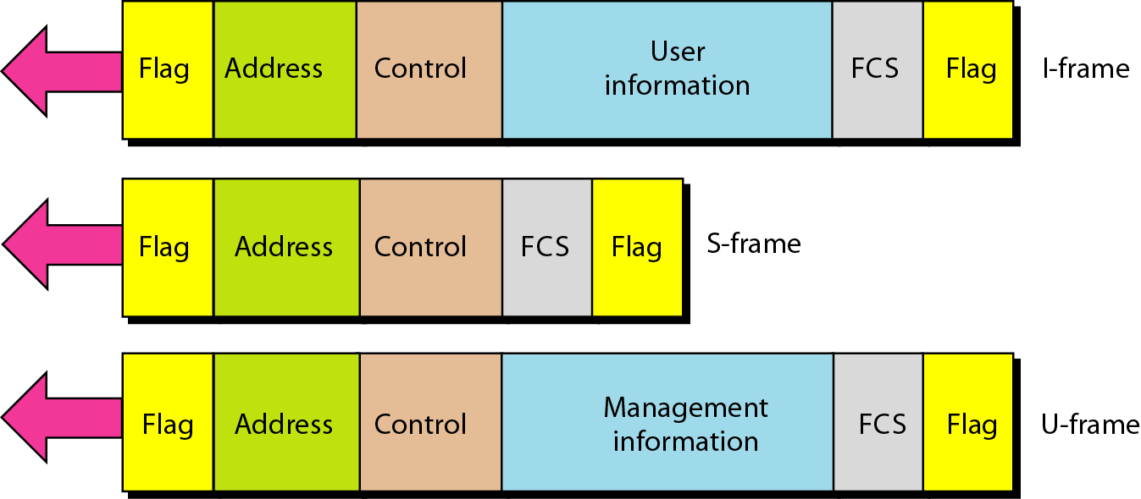
Figure 11.27 HDLC frames
11.<number>

Slide 5
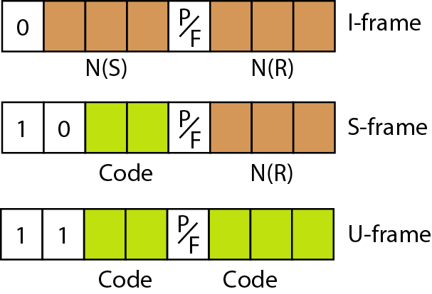
Figure 11.28 Control field format for the different frame types
11.<number>

Slide 6
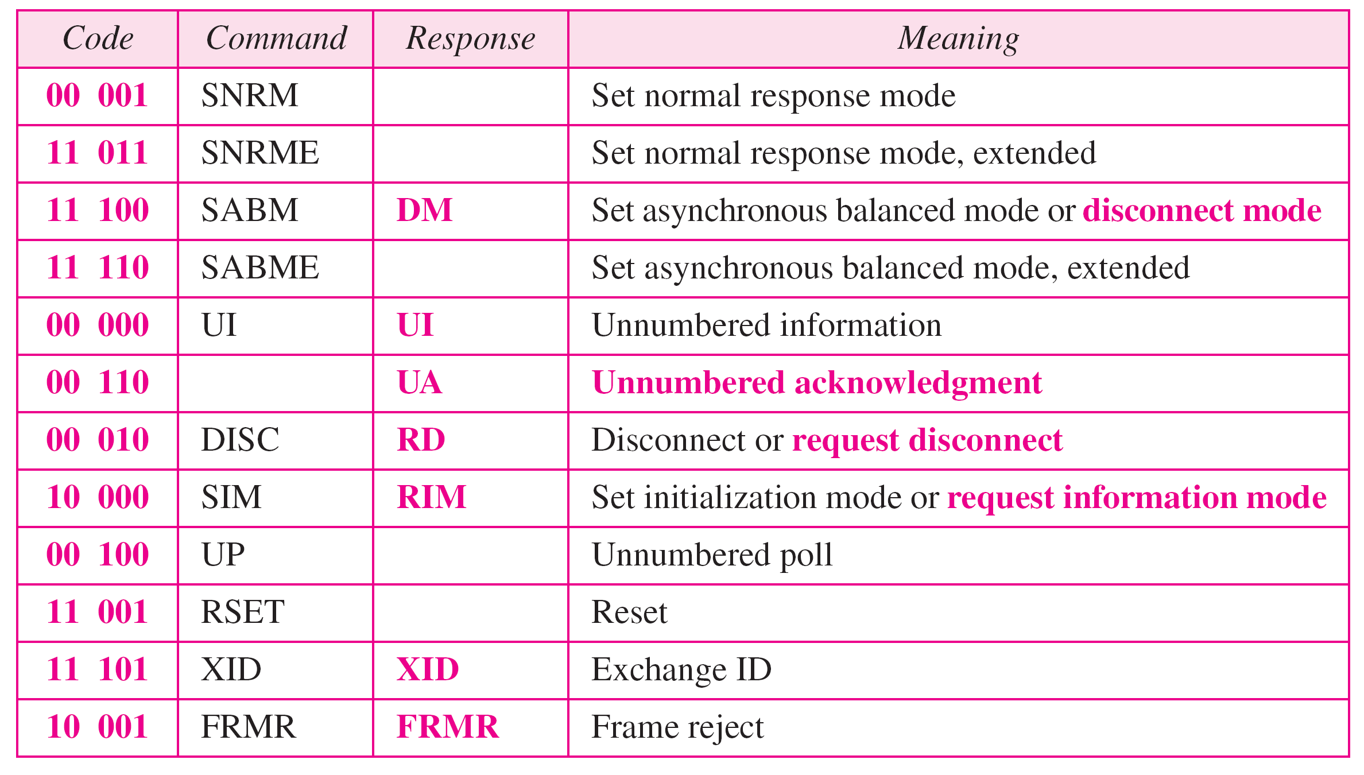
Table 11.1 U-frame control command and response
11.<number>

Slide 7
11-7 POINT-TO-POINT PROTOCOL
Although HDLC is a general protocol that can be used for both point-to-point and multipoint configurations, one of the most common protocols for point-to-point access is the Point-to-Point Protocol (PPP). PPP is a byte-oriented protocol.
Topics discussed in this section:
Services
Framing
Transition Phases
Multiplexing
Multilink PPP
11.<number>

Slide 8
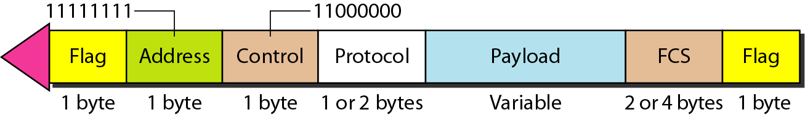
Figure 11.32 PPP frame format
11.<number>

Slide 9

Note
PPP is a byte-oriented protocol using byte stuffing with the escape byte 01111101.
11.<number>

Slide 10
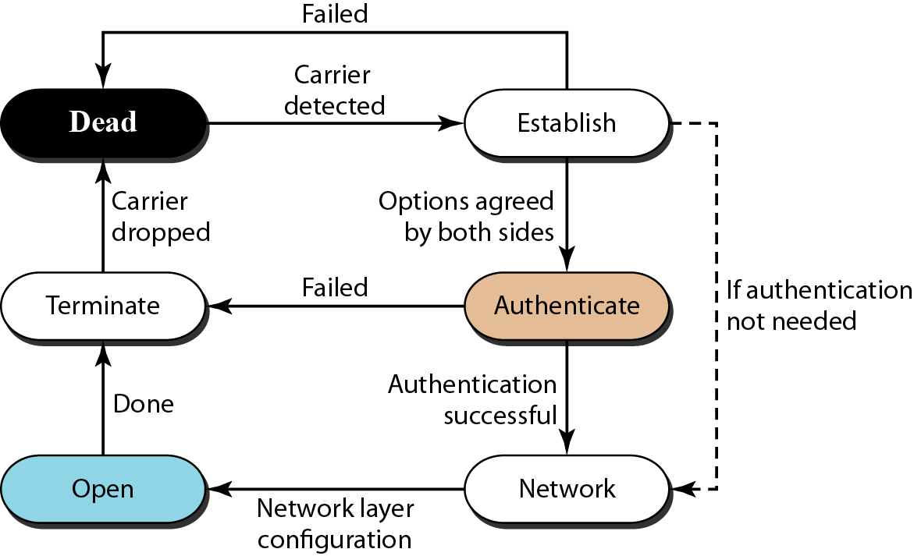
Figure 11.33 Transition phases
11.<number>

Slide 11
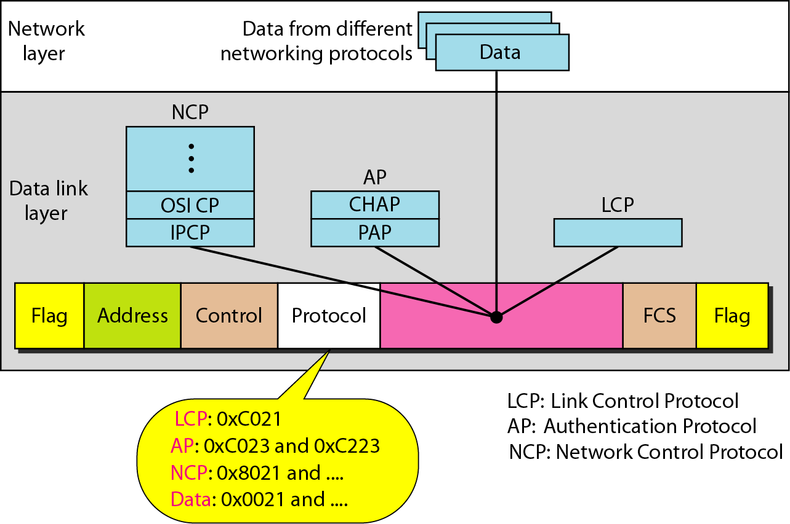
Figure 11.34 Multiplexing in PPP
11.<number>

Slide 12
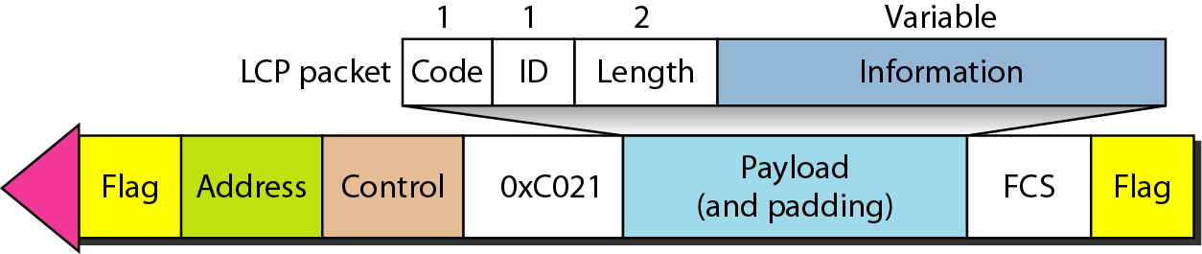
Figure 11.35 LCP packet encapsulated in a frame
11.<number>

Slide 13
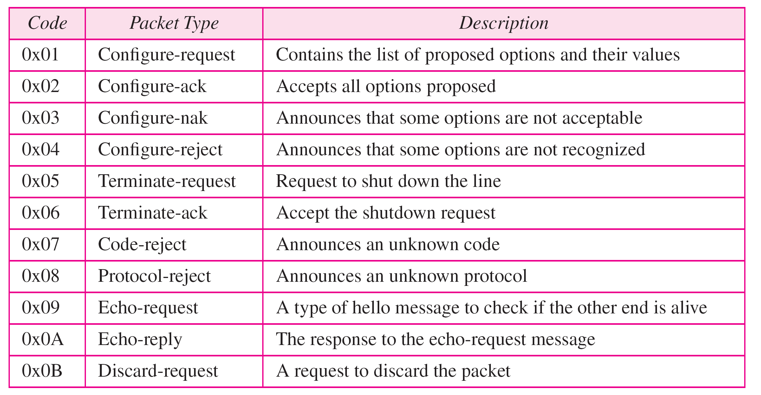
Table 11.2 LCP packets
11.<number>

Slide 14
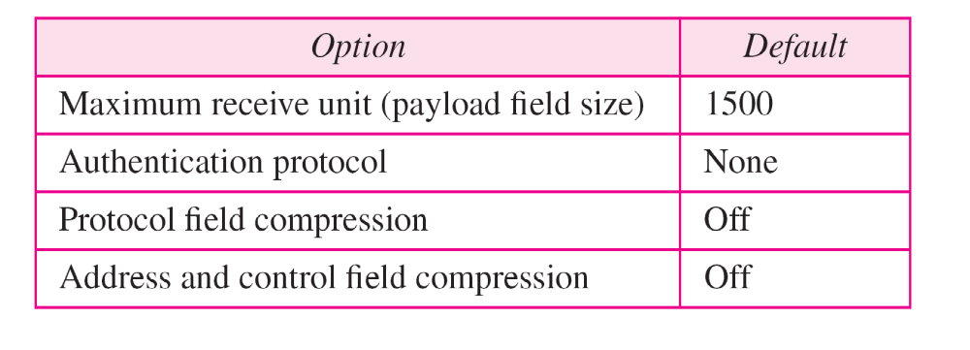
Table 11.3 Common options
11.<number>

Slide 15
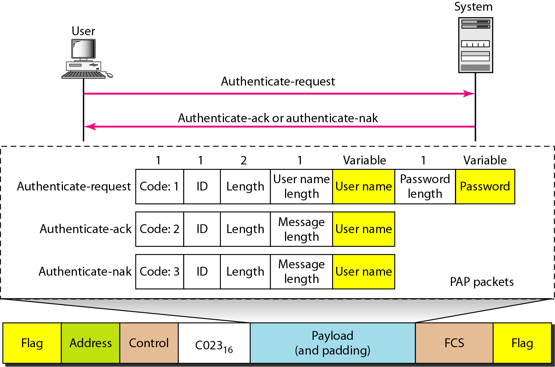
Figure 11.36 PAP packets encapsulated in a PPP frame
11.<number>

Slide 16
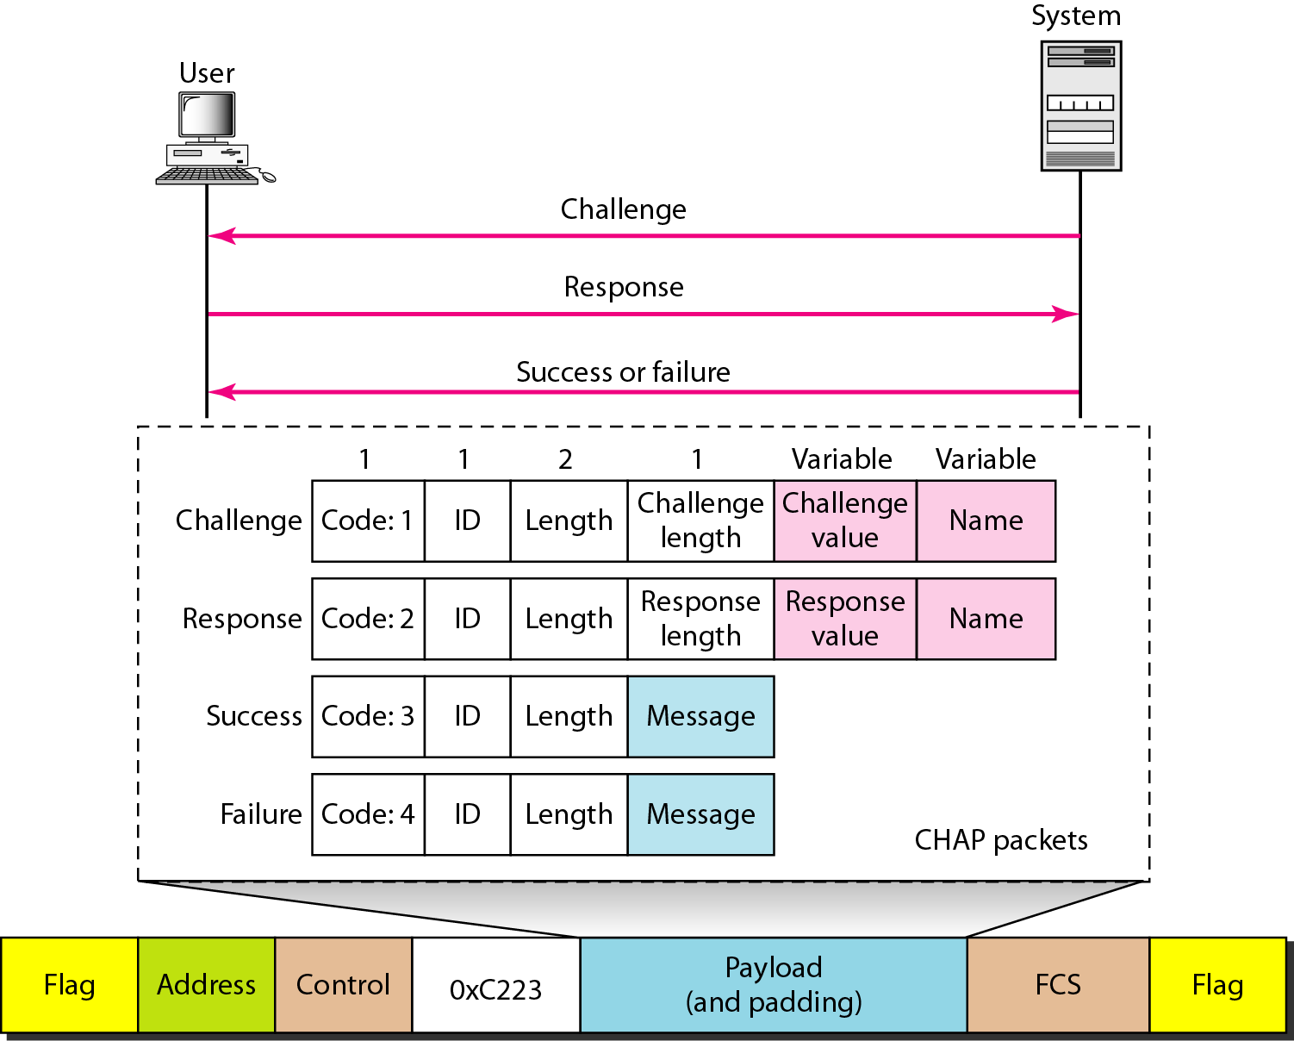
Figure 11.37 CHAP packets encapsulated in a PPP frame
11.<number>

Slide 17
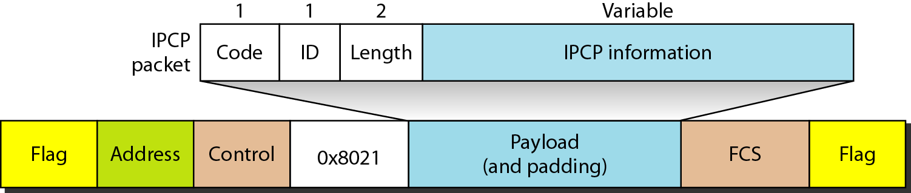
Figure 11.38 IPCP packet encapsulated in PPP frame
11.<number>

Slide 18
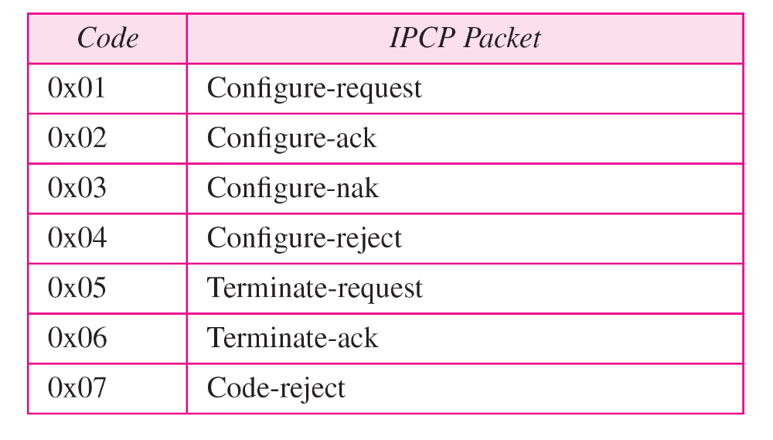
Table 11.4 Code value for IPCP packets
11.<number>

Slide 19
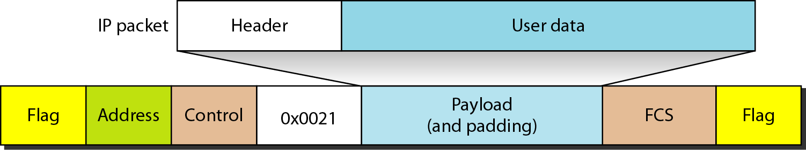
Figure 11.39 IP datagram encapsulated in a PPP frame
11.<number>

Slide 20
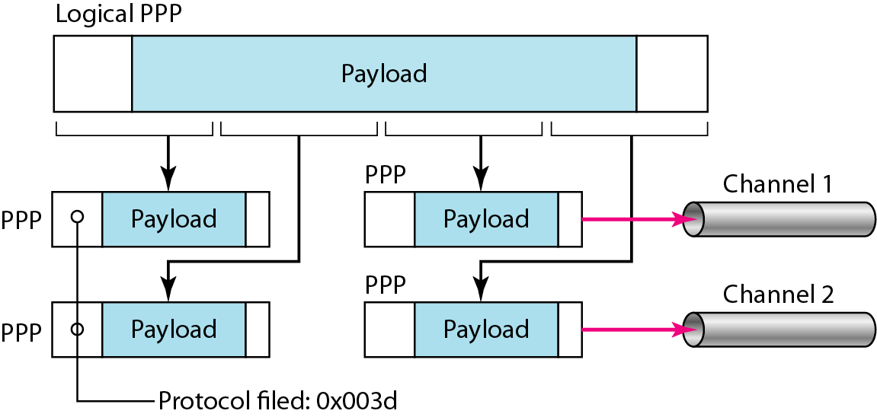
Figure 11.40 Multilink PPP
11.<number>

